Slide 1

So how do I make my images responsive?

Slide 2
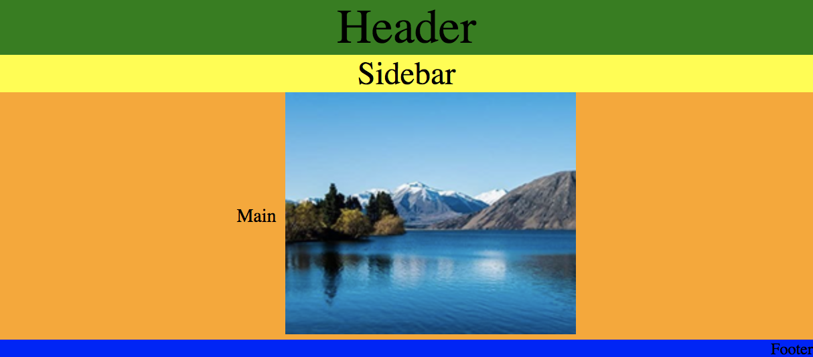
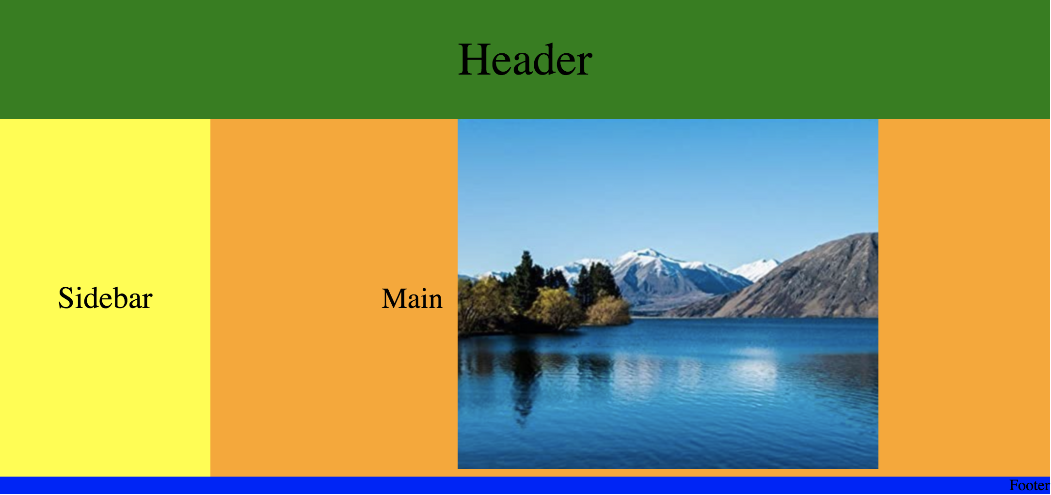
Mobile -> Desktop

Slide 3

Flexible images
Using the max-width Property
If the max-width property is set to 100%, the image will scale down if it has to, but never scale up to be larger than its original size:
CSS

Slide 4
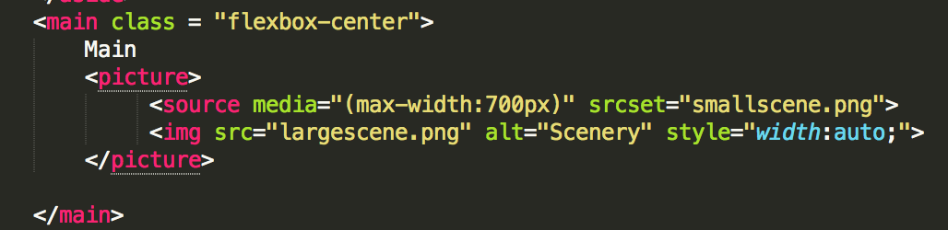
Flexible images
HTML5 <picture> Element
Use more than one image when serving an image for a web page
Using https://picresize.com/ reduce the size of largescene.png, so now there are 2 versions of the image – largescene.png and smallscene.png

